Slide 1
Predicting Future Scientific Research with Knowledge Graphs
Matheus Schmitz
Rehan Ahmed

Slide 2





The Big Picture
Find Relevant Articles
Extract Important Data
Iterate and Store Results
Build Knowledge Graph
Create Training Data and Learn
Predict 2021 Papers from Recent Years
Knowledge Graph Construction Phase
Machine Learning Phase

Slide 3
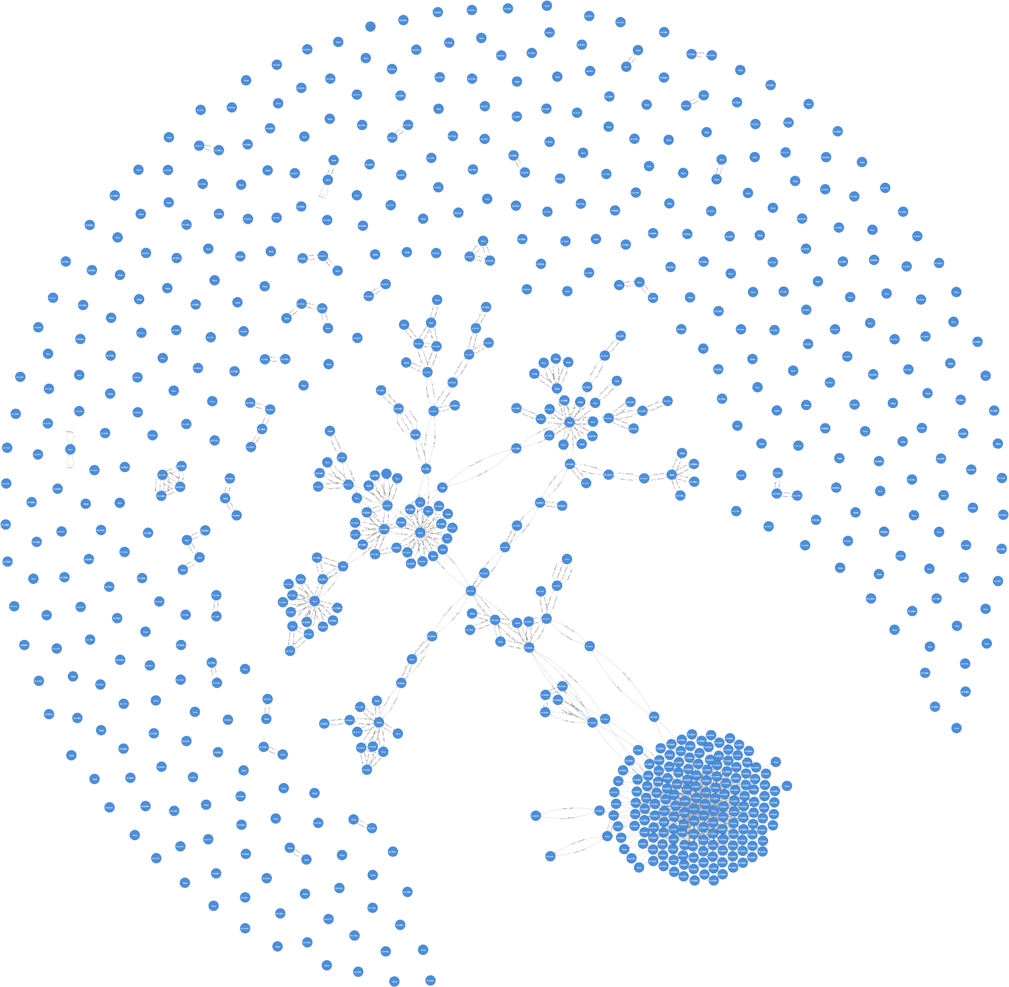
Challenges
Papers by one author:
(1) Building a connected graph:
Too much data out there, over 50k CS papers published per year on arXiv alone!
(2) Handling papers referenced in the KG but not crawled

Slide 4

Challenges
(3) Making plausible inferences about the future!
(And not generating predictions that are merely a reshuffling of their sources’ abstracts)
(4) Making the graph useful
(You don’t need a KG to look up papers by author or title)

Slide 5




Data Sources
Extract citations and references
Popular articles
Abstracts for the popular articles
“Seed trail” crawling

Slide 6

Web Scraping
Reference
Seed
Reference
Reference
Reference
Notes:
Complimentary seeds:
Most relevant new papers on Google Scholar;
The paper that started research in Capsule Neural Networks.
Targeted crawling based on citations and references from already extracted papers, ensuring the graph will be connected!

Slide 7
Entity Resolution
43 Million Pairs
Reduction Ratio: 0.93
3M pairs compared
Result: 20534 records
(1) Link Using
Title
Author
Date
Final Dataset
(2) Link Using
DOI
(3) Link Using
Title
Author
DOI

Slide 8

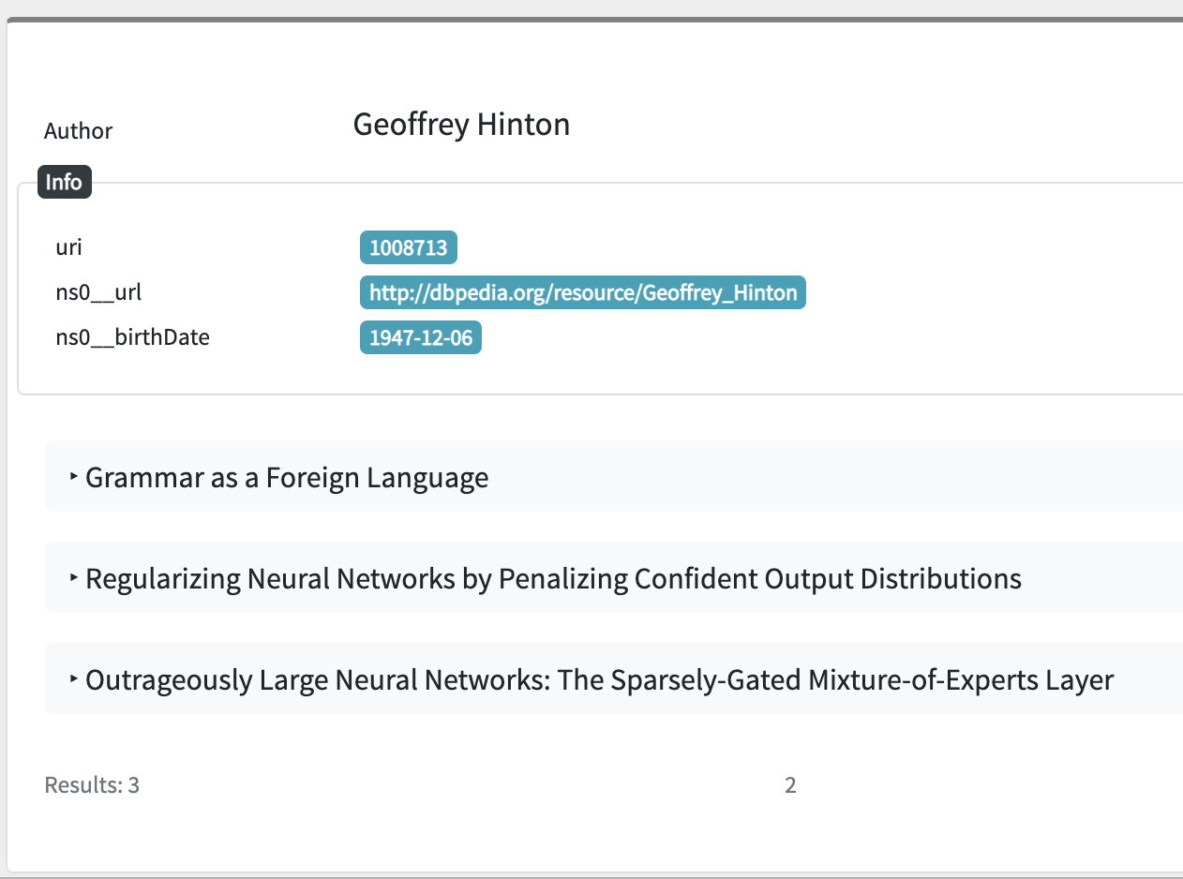
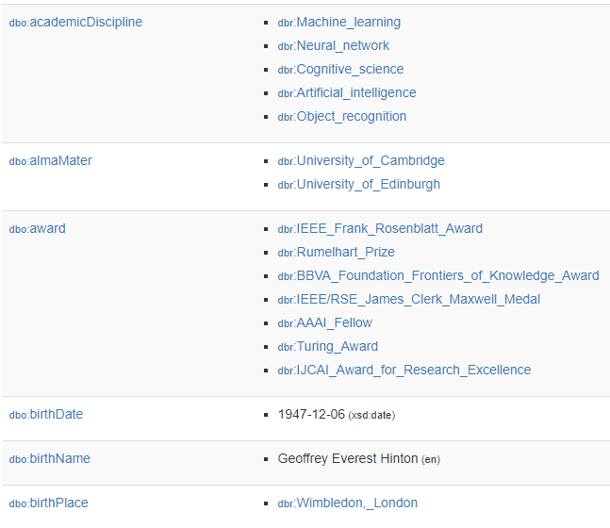
External KG Linkage
Our Knowledge Graph

Slide 9
Triple Generation
Papers
Title
453k Paper URIs (incl. references)
51k Author URIs
298 DBpedia Matches
383 Predicted Papers
207 Genres
86 Publishers
1.5M Relationships
505k Nodes
2.65M Triples!
Authors
Journals
5 Entity Types
6 Predicate Types
12 Property Types
Abstract
Citations
URL
DBPedia
Date
Genres
DOI
Birthdate
References

Slide 10
Ontology
abstract
PageRank
Predicted Research
name
Publisher
PageRank
headline
abstract
URL
doi
Source
Source
Publisher
Scholarly Article
Scholarly Article
Reference
Person
Author
influentialCitationCount
citationVelocity
dateModified
datePublished
name
Genre
Genre
Citation
name
birthdate
DBPedia URL
...

Slide 11
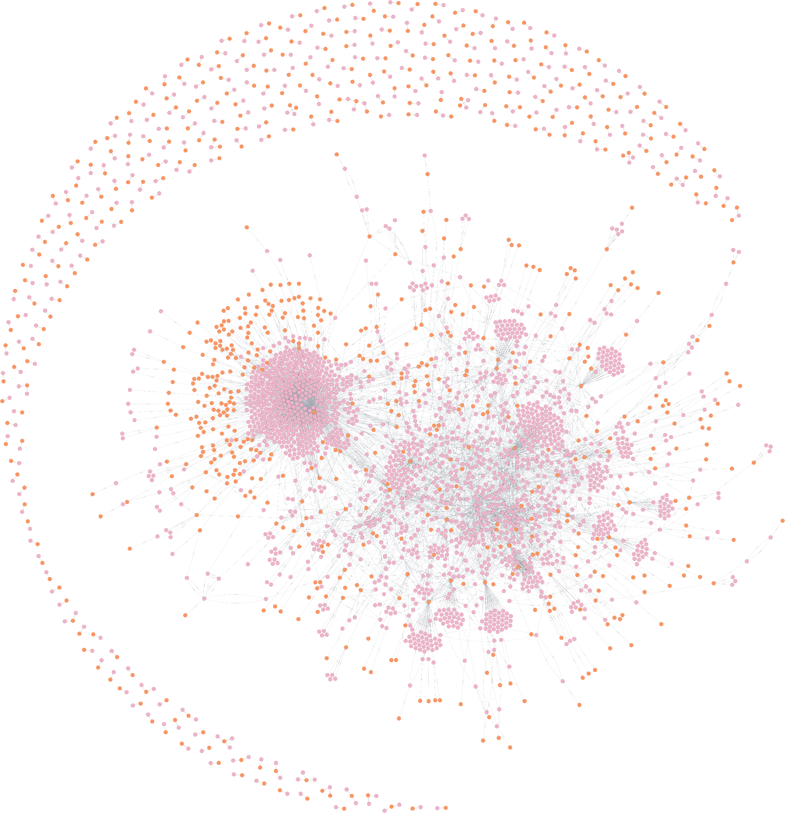

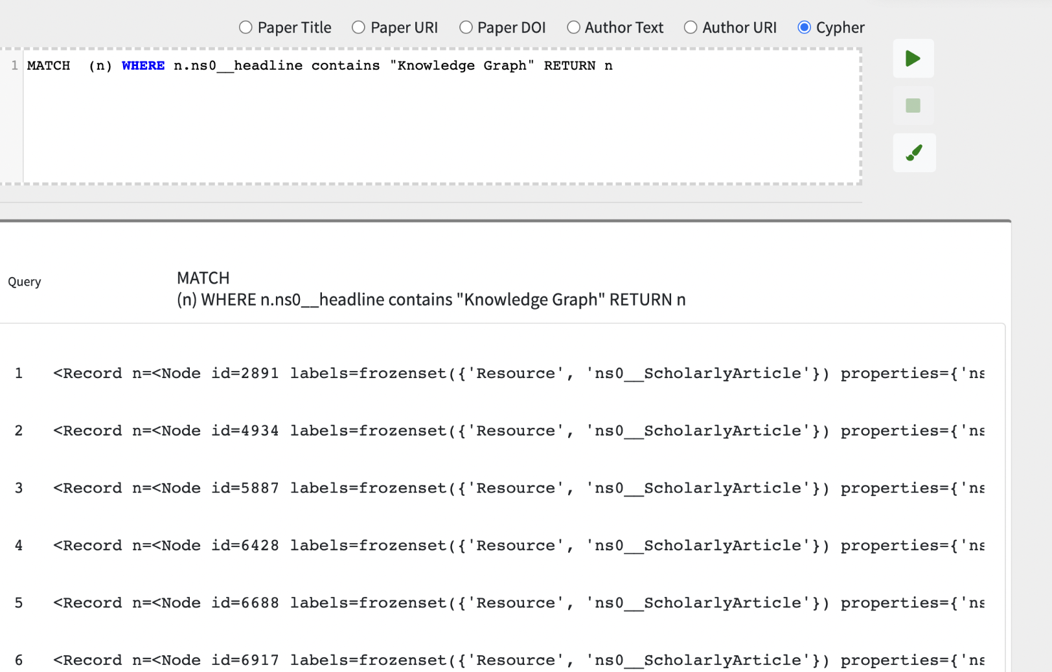
Graph Database

Slide 12
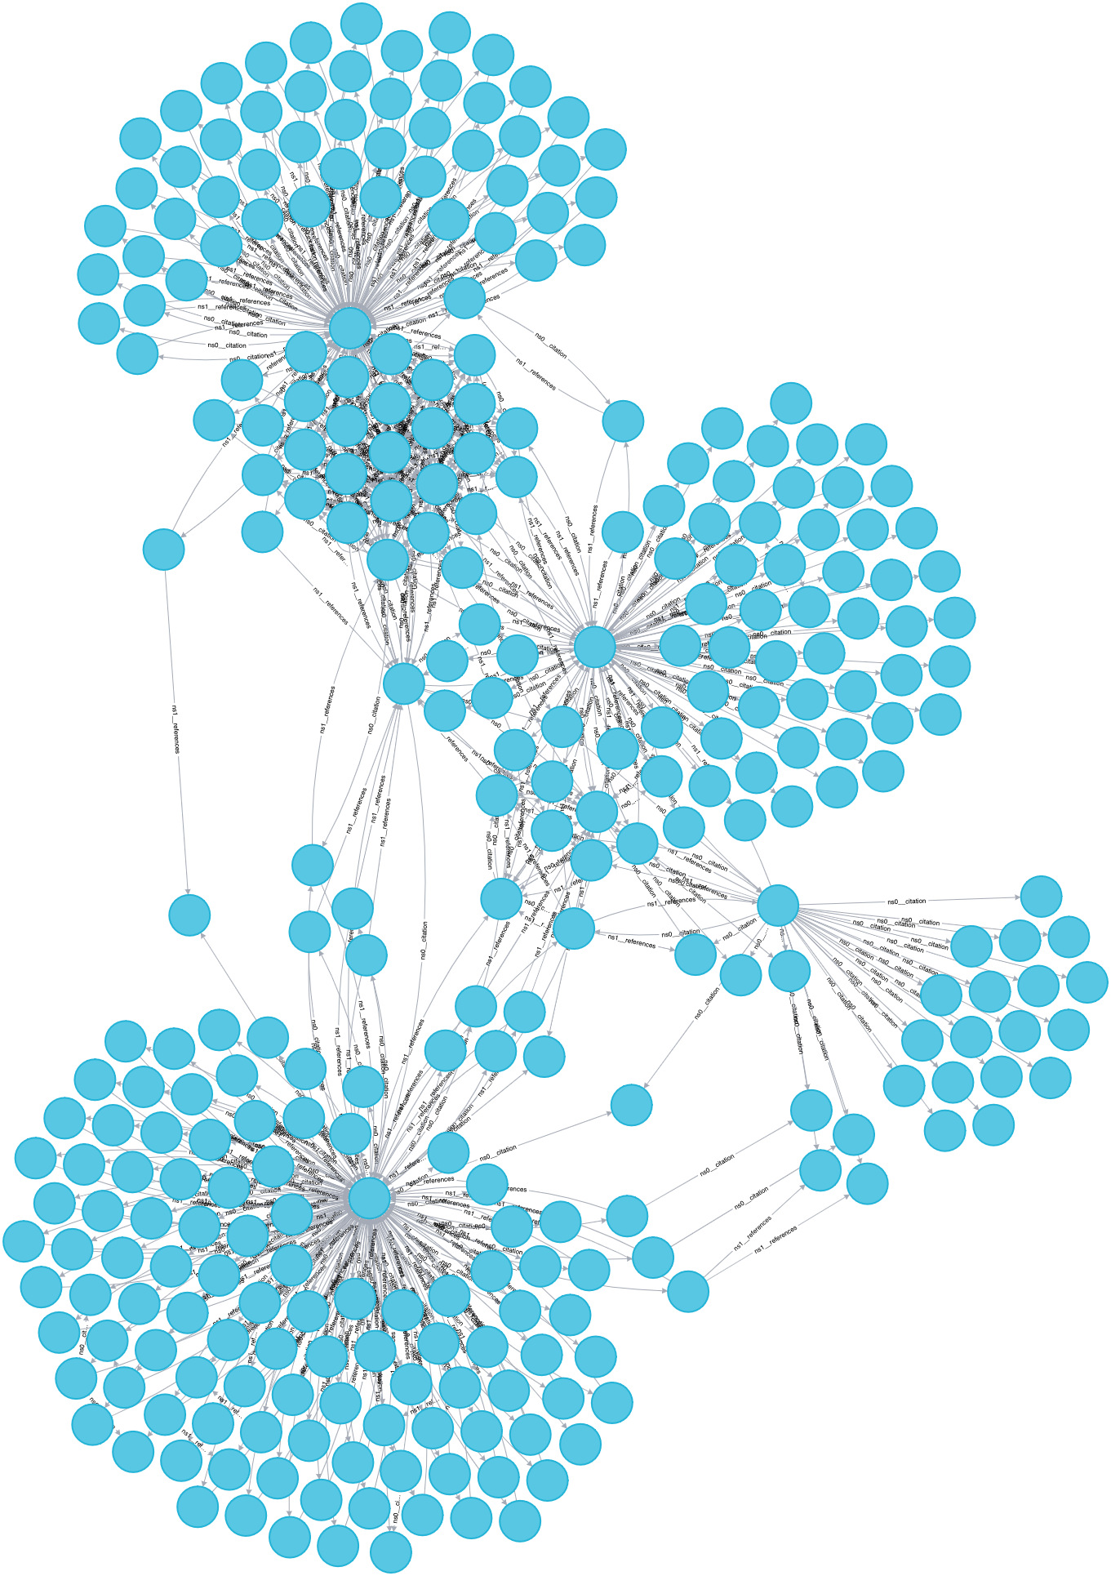
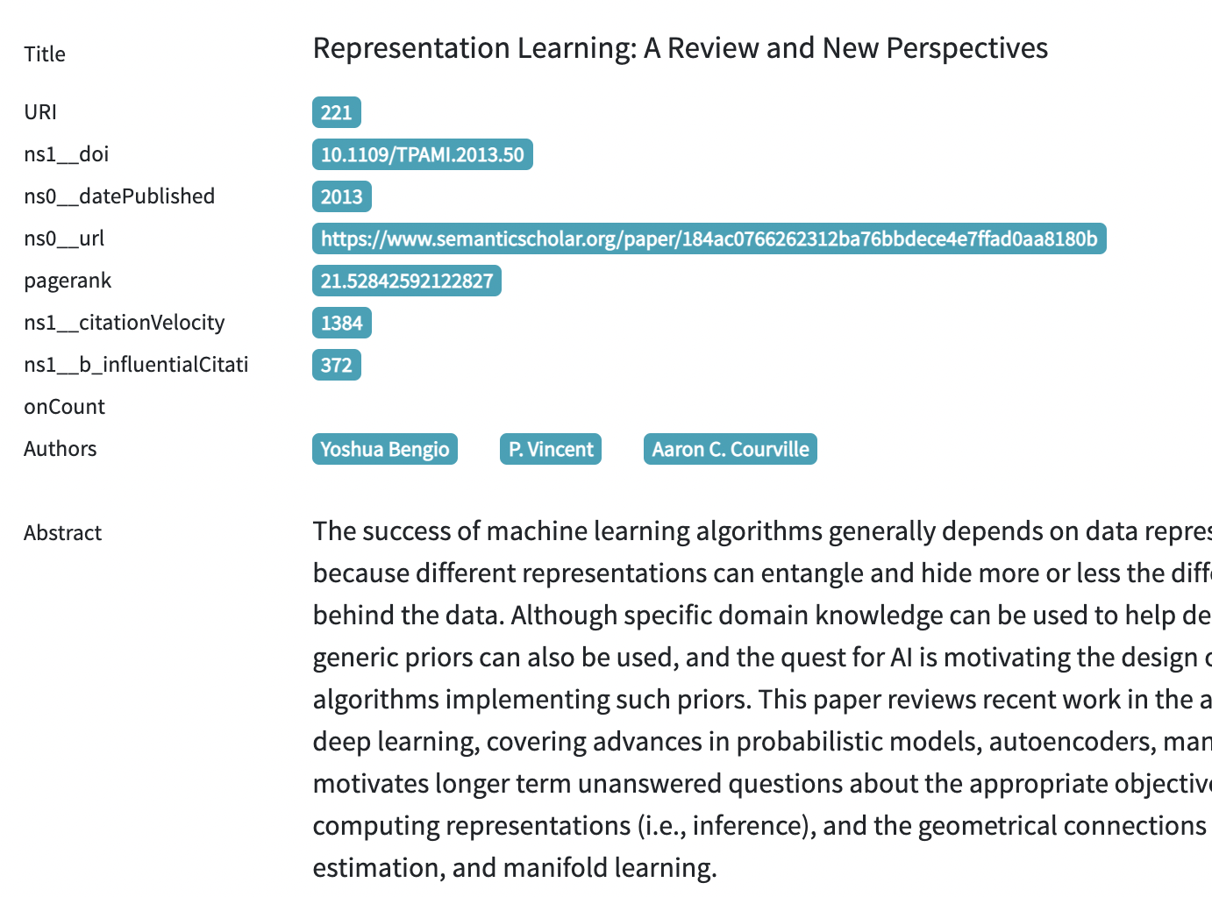
PageRank
Sample Endpoint Query:

Slide 13


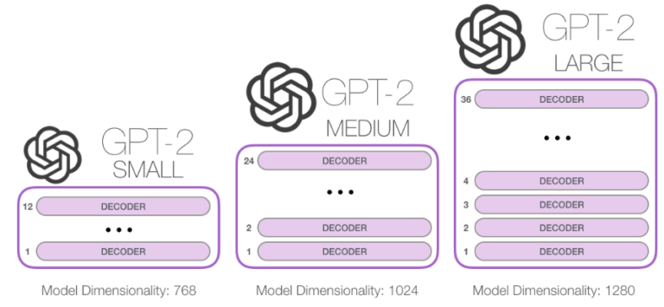

Predicting Future Research

Slide 14

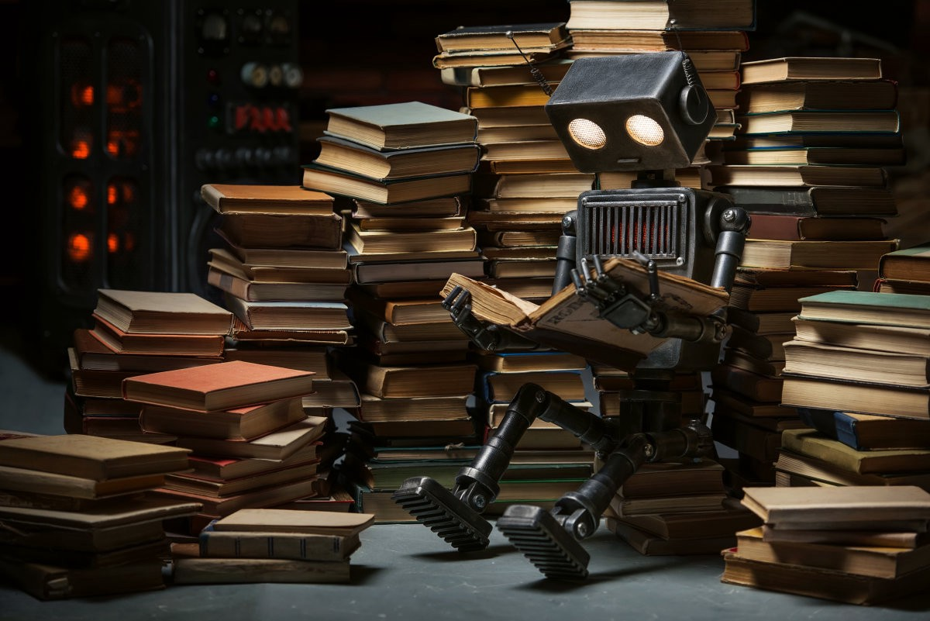
Predicting Future Research
(1) Reading the reference abstracts (priming the model)
(2) Writing an entire new paper (text generation)
(3) Writing the paper’s abstract (text summarization)

Slide 15
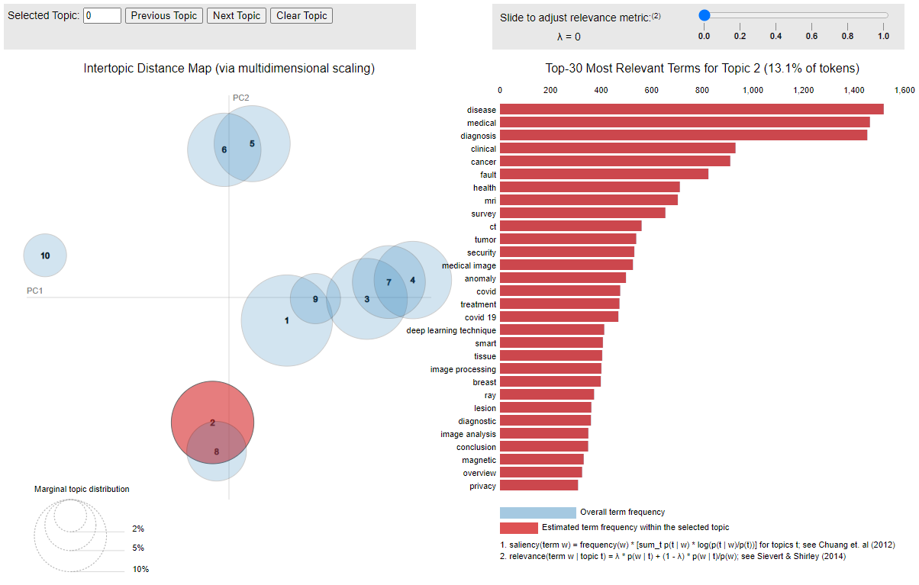
Topic Modeling
BONUS!
Medicine
Latent Dirichlet Allocation

Slide 16
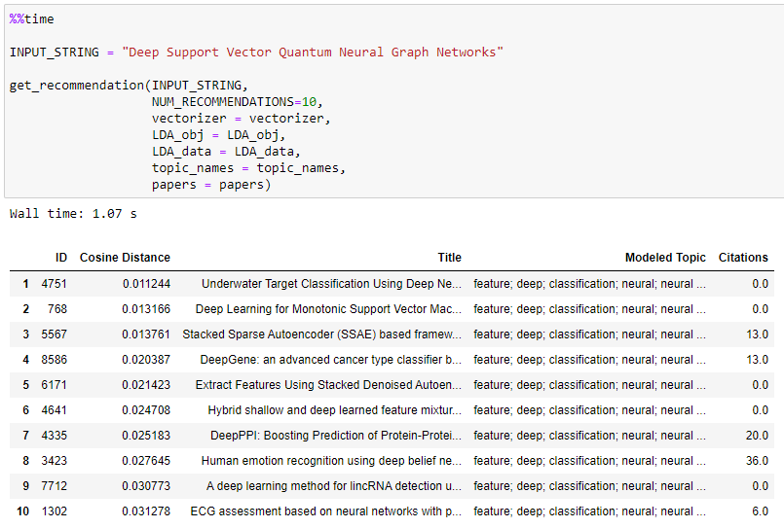
Recommender System
BONUS!
Trained on the entire graph
Paper recommendations using LDA similarity between input and abstracts
Not reliant on searching keywords in the database
Even hosted on a local machine can return query in 1 second

Slide 17
Validation
Validation Set: 98.4% TPR on DBpedia authors
Novelty in Generated Abstracts:
Only 7% of synthetic papers find their sources on the top 5 recommendations
Full dataset: 0.02% self-evident FPs (impossible 3-way matches)
Validation Set: 99.53% TPR on record linkage
Reduction Ratio: 0.93

Slide 18
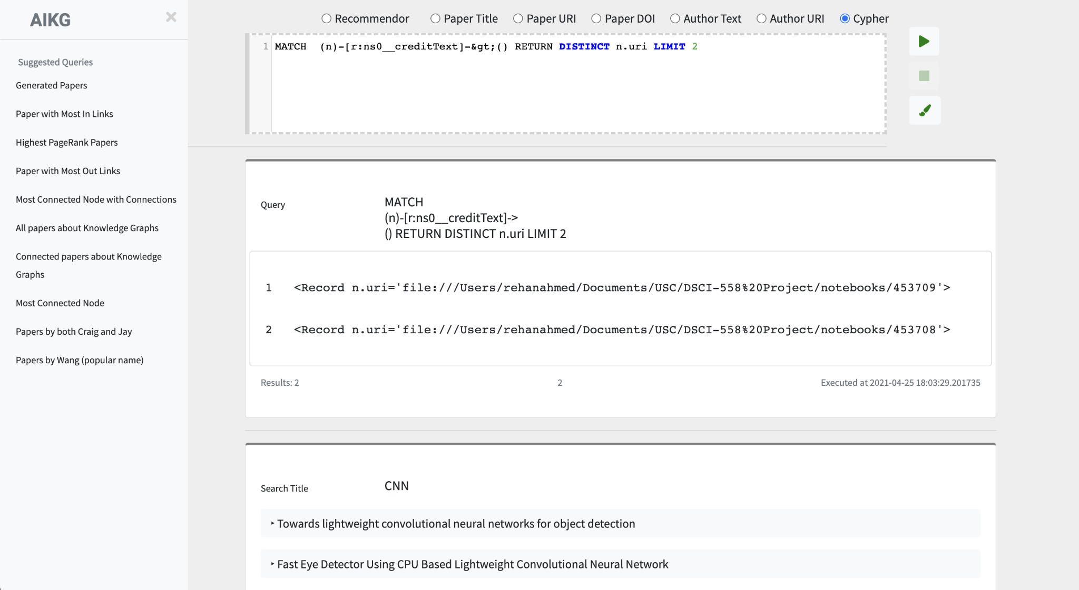
Final Result
Recommender System
Text Query
Neo4J Endpoint
Research Predictions
+ LDA Topic Modeling
PageRank
DBpedia

Slide 19

Training a Facial Recognition Neural-Net from Brain Activity
Neural-Net for Traffic Control on Foggy Days
'A sparse deep belief network with efficient fuzzy learning framework The algorithm is based on a deep neural network that is able to learn to distinguish between different types of blurred scenes . The algorithm can be applied to any scene, including static and dynamic ones, and it can also be used to improve the performance of existing algorithms . The authors demonstrate the use of deep learning in traffic prediction by using a network trained on real traffic data to train a model that could predict how fast a particular vehicle would be traveling at any given time of day, based on its speed in relation to other vehicles, such as cars, trucks, buses, motorcycles, bicycles, etc. In this way, the researchers demonstrate how deep networks can be used in a wide range of problems, including traffic management, vehicle safety, traffic congestion, urban planning, transportation planning and transportation planning . They hope that this work will inspire other researchers to explore the potential of this approach in other areas of this type of engineering . The work was supported by the U.S. National Science Foundation (NSF)'
"The reconstructions capture individual-specific information, such as the location of the eyes, nose, mouth, and other facial features, as well as their shape and size . This information can be used to improve the model's performance in a number of ways . For example, it is possible to use the reconstructed images to train a model to recognize faces . In this way, we are able to capture the individual features of a face and use them to predict the face's identity . We also use this information to enhance the performance of our model in other ways, for instance, by using it to detect faces that are not in the image . Our method is based on a combination of two approaches: (1) the use of a network-based approach and (2) a neural network based approach . Our model is able to extract features from the neural activity of a human subject, including the shape and shape of their dendritic trees . We show that our method can also be used as a tool for reconstruct"
typo
Notes:
Idx 0: “Traffic on Foggy Days”
Idx 97: “Facial Recognition Model Trained on Brains”

Slide 20

Thank You!
Questions?

